Slide 1
Physical geology

Slide 2
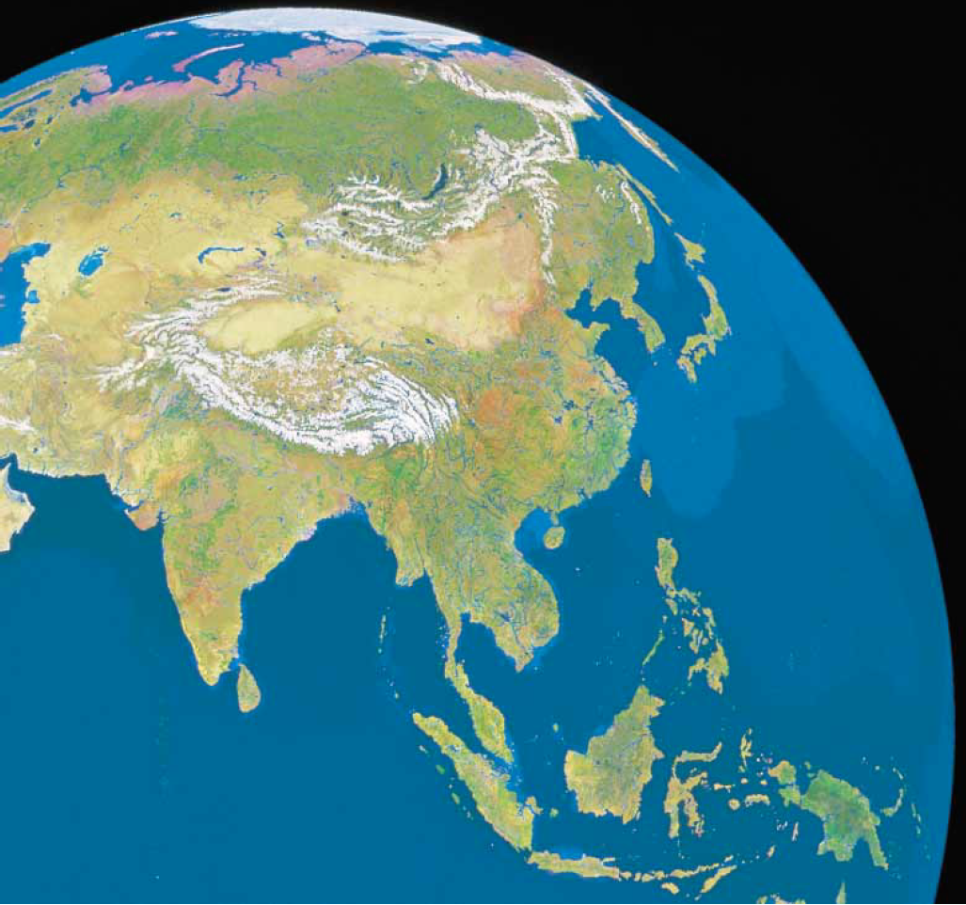

Slide 3
Lecture - 11

Slide 4
Headline Of Physical Geology Course
1- preface
2- Atom ,Element, and Minerals
3- Igneous Rocks, Intrusive Activity and The Origin of Igneous Rocks
4- Volcanism and Extrusive Rocks
5- Weathering and Soil
6- Sediments and Sedimentary Rocks
7- Metamorphism and Metamorphic Rocks
8- Time and Geology
9- Stream and Floods and Ground Water
10- Plate Tectonics
11-Geologic Resources

Slide 5
Plate Tectonics

Slide 6
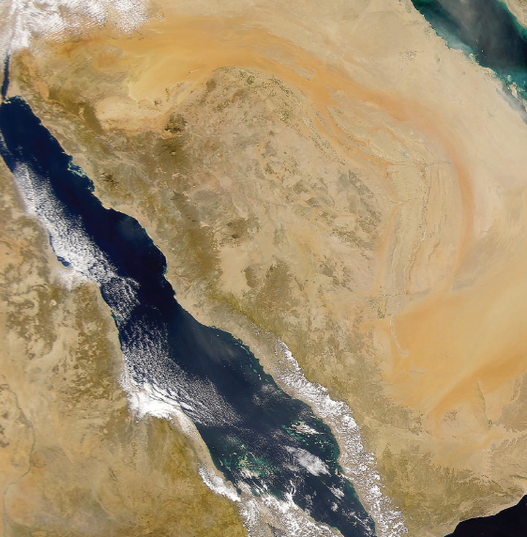

Slide 7
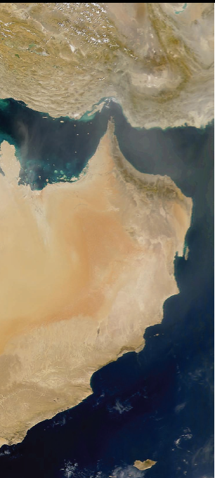

Slide 8
Headline Of Physical Geology
Lecture -11
1- THE EARLY CASE FOR CONTINENTAL DRIFT
2- PALEOMAGNETISM AND THE REVIVAL OF CONTNENTAL DRIFT
3- SEAFLOOR SPREADING
4- PLATES AND PLATE MOTION
5- HOW DO WE KNOW THAT PLATES MOVE?
6- DIVERGENT PLATE BOUNDARIES
7- TRANSFORM BOUNDARIES
8- CONVERGENT PLATE BOUNDARIES
9- THE MOTION OF PLATE BOUNDARIES
10- PLATE SIZE
11- THE ATTRACTIVENESS OF PLATE TECTONICS
12- WHAT CAUSES PLATE MOTIONS?
13- A FINAL NOTE
14- SUMMARY

Slide 10
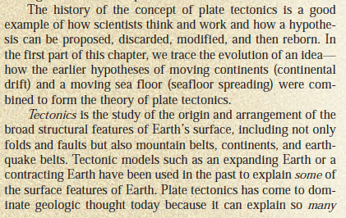

Slide 11
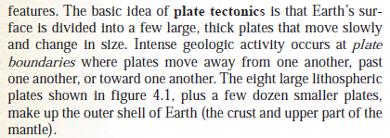

Slide 12
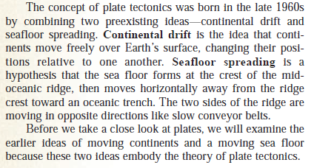

Slide 13
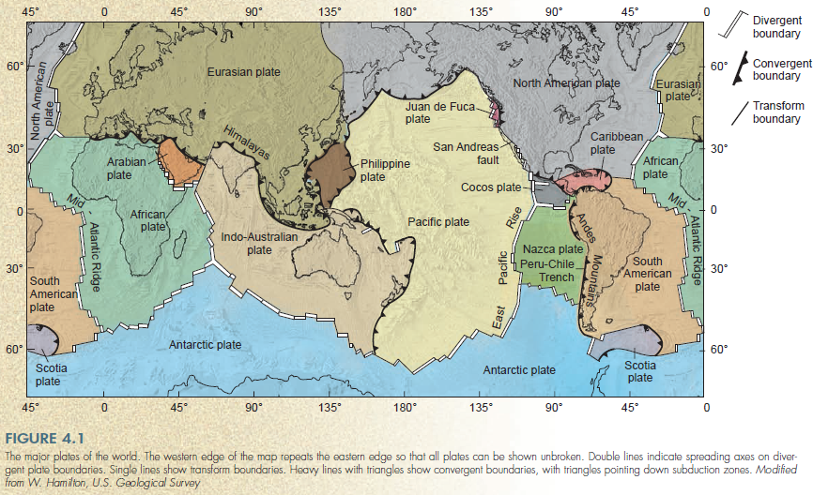

Slide 15
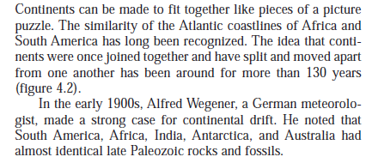

Slide 16
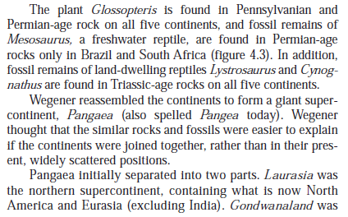

Slide 17
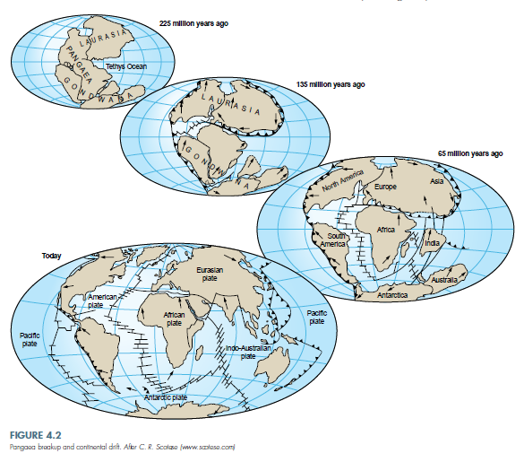

Slide 18
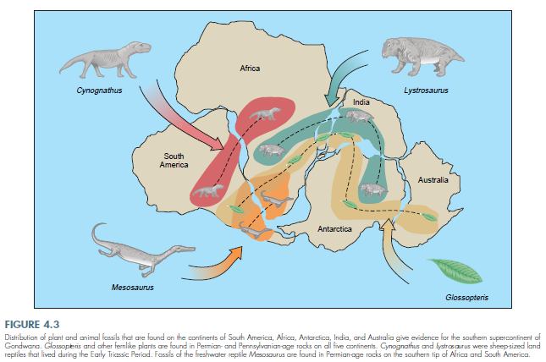

Slide 19
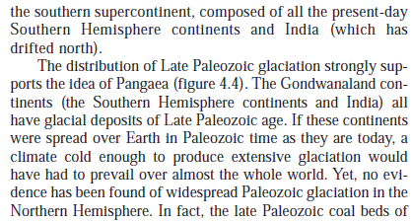

Slide 20
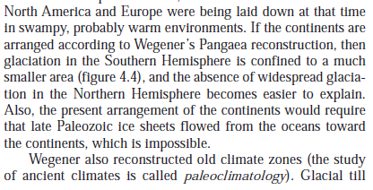

Slide 22
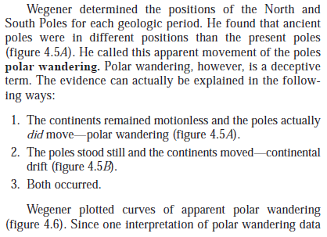

Slide 23
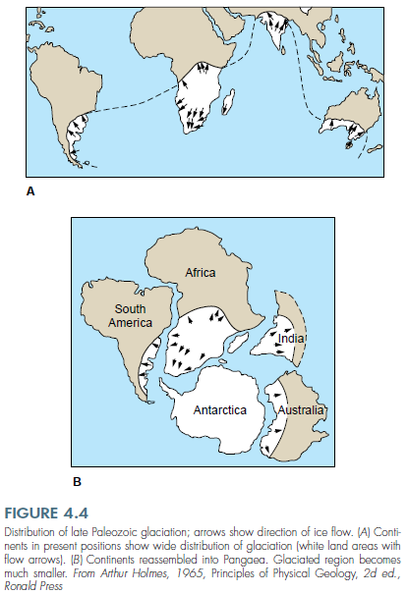

Slide 24
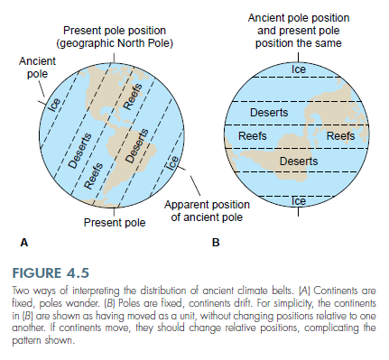

Slide 25
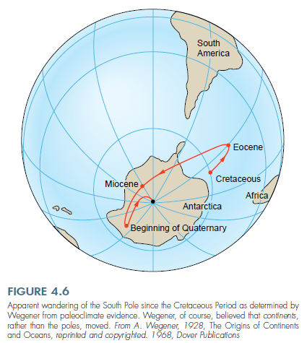

Slide 28
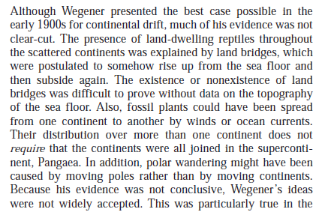

Slide 29
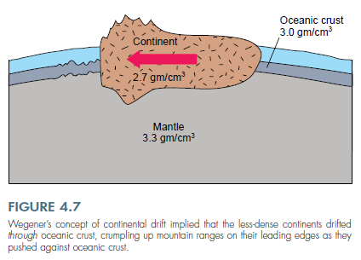

Slide 30
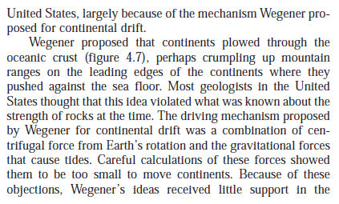

Slide 31
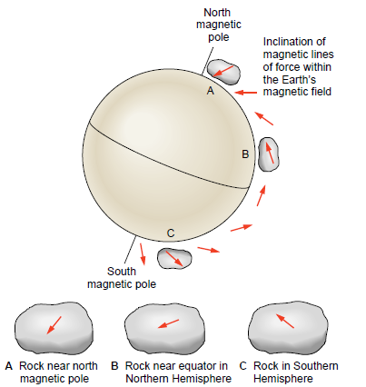

Slide 34
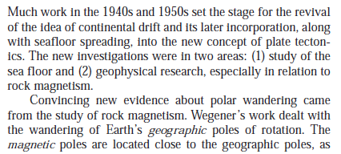

Slide 35
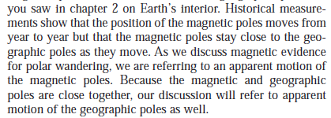

Slide 36
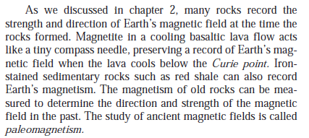

Slide 37
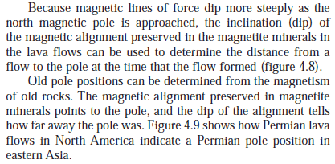

Slide 38
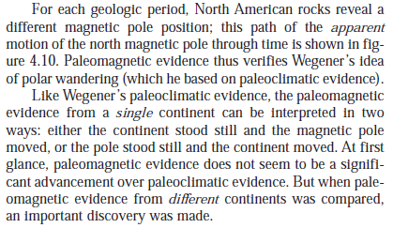

Slide 39
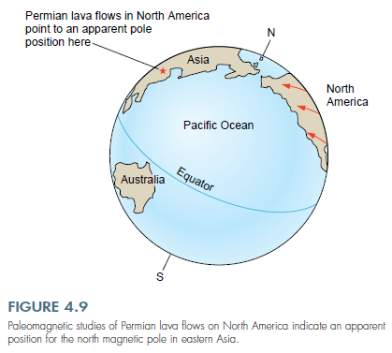

Slide 40
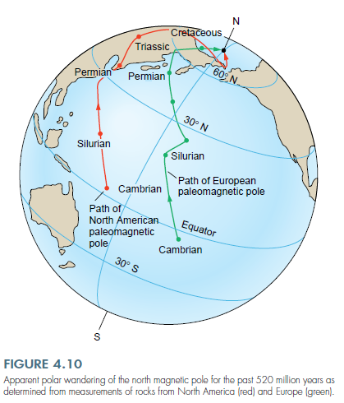

Slide 41
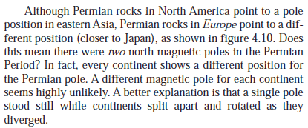

Slide 42
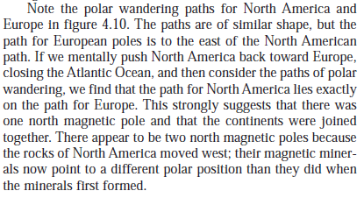

Slide 45
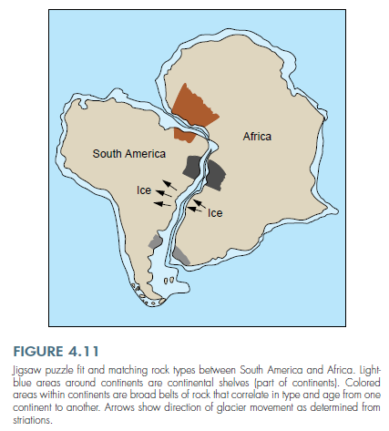

Slide 46
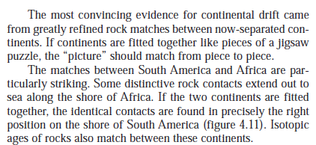

Slide 47
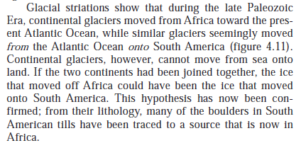

Slide 48
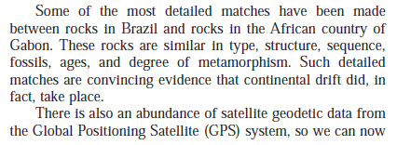

Slide 50
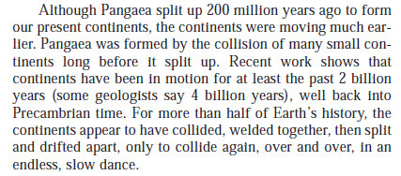

Slide 52
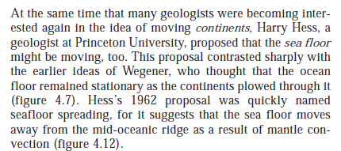

Slide 53
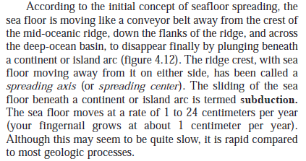

Slide 56
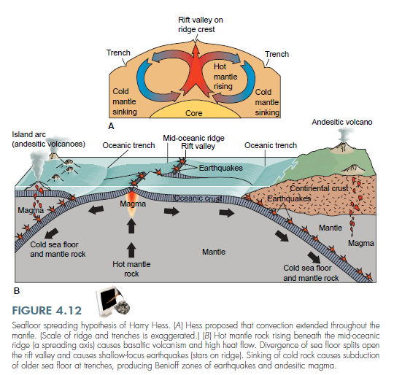

Slide 57
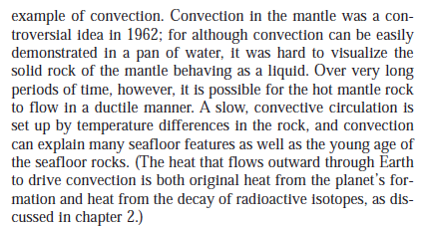

Slide 59
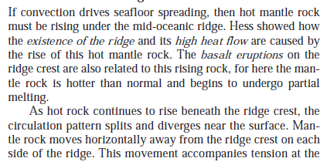

Slide 60
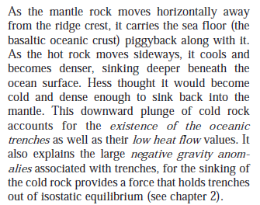

Slide 61
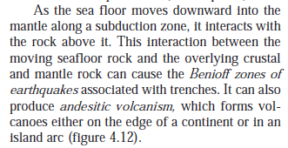

Slide 63
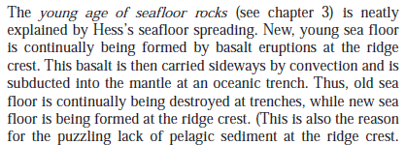

Slide 64
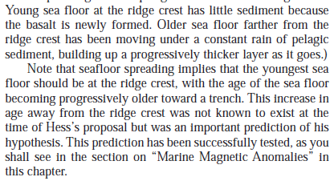

Slide 69
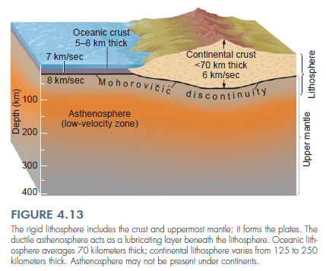

Slide 71
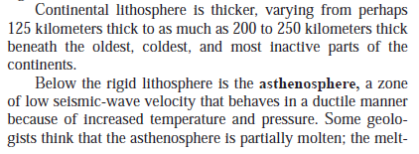

Slide 72
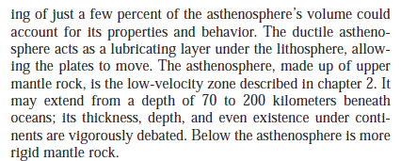

Slide 73
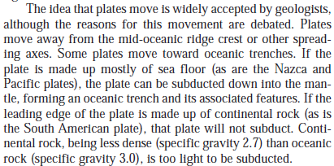

Slide 77
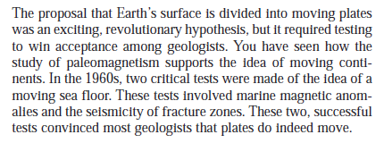

Slide 79
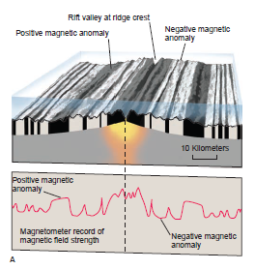

Slide 228
Summary

Slide 239
Questions

Slide 256
References

